Slide 1
Javascript
Objects

Slide 2
Objects

Slide 3
Creating Objects

Slide 4
Creating an Object
<!DOCTYPE html>
<html>
<body>
<p>Creating a JavaScript Object.</p>
<p id="demo"></p>
<script>
var person = {firstName:"John", lastName:"Doe", age:50, eyeColor:"blue"};
document.getElementById("demo").innerHTML =
person.firstName + " is " + person.age + " years old.";
</script>
</body>
</html>
Method 1
Using an Object Literal (single )

Slide 5
Creating an Object
<!DOCTYPE html>
<html>
<body>
<p id="demo"></p>
<script>
var person = new Object();
person.firstName = "John";
person.lastName = "Doe";
person.age = 50;
person.eyeColor = "blue";
document.getElementById("demo").innerHTML =
person.firstName + " is " + person.age + " years old.";
</script>
</body>
</html>
Method 2
Using the new Keyword

Slide 6
<!DOCTYPE html>
<html>
<body>
<h2>JavaScript Object Constructors</h2>
<p id="demo"></p>
<script>
// Constructor function for Person objects
function Person(first, last, age, eye) {
this.firstName = first;
this.lastName = last;
this.age = age;
this.eyeColor = eye;
this.name = function() {
return this.firstName + " " + this.lastName
};
}
// Create a Person object
var myFather = new Person(“Fawad", “Gul", 50, "blue");
// Display full name
document.getElementById("demo").innerHTML =
"My father is " + myFather.name();
</script>
</body>
</html>
Creating an Object constructor
Method 3
Create an Object Constructor then create objects of the constructed type

Slide 7
Prototype

Slide 8
<!DOCTYPE html>
<html>
<body>
<h2>JavaScript Objects</h2>
<p id="demo"></p>
<script>
function Person(first, last, age, eye) {
this.firstName = first;
this.lastName = last;
this.age = age;
this.eyeColor = eye;
}
Person.prototype.name = function() {
return this.firstName + " " + this.lastName
};
var myFather = new Person("John", "Doe", 50, "blue");
document.getElementById("demo").innerHTML =
"My father is " + myFather.name();
</script>
</body>
</html>
The JavaScript prototype property also allows you to add new methods objects constructors:

Slide 9
Hangman

Slide 10
Requirement
Hangman Prototype game
Must Have
Instructions on how to play the game
User can enter a letter and receive feedback on the attempt
Letter is checked for not being a repeated selection
Nice to have
User has a limited number of attempts to guess the word
User has option to start game
Wishlist
Hangman Graphics used to match number of attempts allowed
Random word is drawn from an API

Slide 11
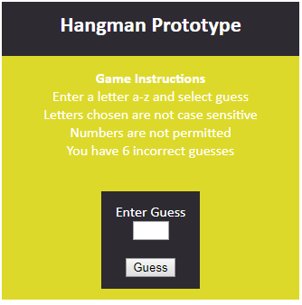
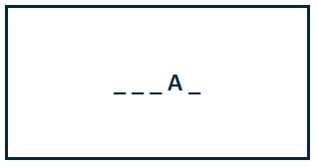
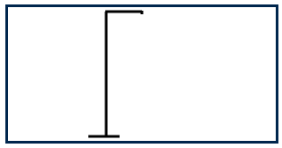
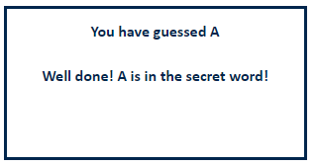
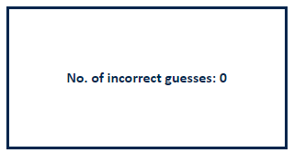
UI
Architecture

Slide 12
Quiz

Slide 13
Brief

Slide 14
UI
Question
Select
Select
Choices
Choices
Choices
Play
Submit
Score
EL: Change Select
Initialise Game()
Load Data
Show Play Button
EL: Click Play Game()
Display First Question
EL: Click Submit()
Check Guess
Display next Question

Slide 15
Vending Machine

Slide 16
Vending Machine
Requirements
To create a simple vending application where the user is presented with a selection of items and can purchase an item from the selection, enter a payment amount and the correct amount of change is given.
The transaction information is shown including what is purchased, amount entered to pay and change given. Change should be returned in the least currency denominations possible.
Assumptions
The programme can dispense the following denominations
£1, £2, £5, £10, £20, £50, 5, 10, 50 cents
different items have different costs

Slide 17
Requirements distributed
Must Have
User can select items to add to basket
User can enter money to pay and pay amount
Correct change given and transaction completed
Transaction summary presented on screen and auto updated
Like to have
users can press a button for requested item type, or to return all input money
user can select quantities for each item
validation
Testing
Session state
Wish list
Remove items from the basket
Add quantities for each item
Image shown for each item
UI Display is mobile responsive

Slide 18
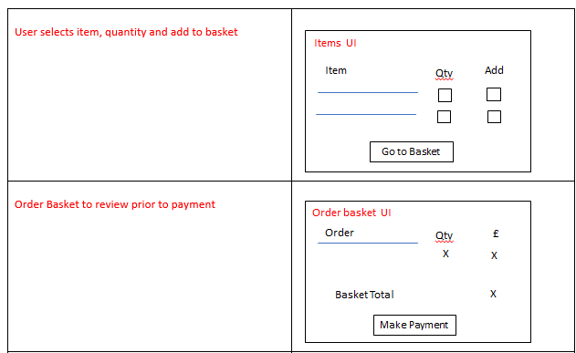
UI Design

Slide 19
